Slide 1
Notes:
Sharing Jesus with Someone through Radical Hospitality
Note that each session will last 45 minutes and you have access to Powerpoint and the internet, if needed.
Hospitality and Neighboring
Romans 12:10ff
Good Samaritan – Neighborly is ultimately a willingness to bear the image of Christ
Another key issue is this: radically ordinary hospitality is never convenient. A good question to ask yourself: What is the difference between inconvenient and impossible?
Second Application: Radical Hospitilty may not be in your home: (lets give each other permission to stretch it…)
1. My Office every Tuesday
2. Scheduled Lunches with Intentionality – My mother set up Bible studies at lunch
3.
Acts 2 were homes the bridge to the church?
James 2 – At church
Usuage of terms in scripture “Hospitality” / “Neighboring”
Single Story
Remember – what do we portray when we share Christ and they don’t respond through faith? The world is watching.
Hospitality and Compassion
Is the way to show the authentic Love and grace Jesus Shared with us
World has Negative Labels of Christians – but many in the world do not know a Christian
Personal Connections – Avoid Single Story pitfalls
Xxxxxxxxxxxxxxxxxxxxxxxxxxxxxxxxxxxxxxxx
NOT ENOUGH CHAIRS
The new preacher loaded his car with his large family and visited an
old deacon on the farm. After the introductions there was an awkward
pause as the unexpected guests looked for chairs upon which to sit.
The parlor had only two chairs.
"Brother, I don't believe you have enough chairs," suggested the
preacher.
"That ain't it," muttered the old man. "I got plenty of chairs --
just too much company!"
Some Christians make it clear they don't want to spend too much time
with other Christians, but how important is our fellowship with our
brothers and sisters in Christ! Living in a hostile environment, we
need the encouragement that comes from those who share the same hopes
and goals that we do.
God knew that we would need each other, that the Christian life would
be difficult if not impossible to live in isolation. That's what the
church is all about. The early Christians certainly recognized the
value of being together:
"Every day they continued to meet together in the temple courts. They
broke bread in their homes and ate together with glad and sincere
hearts." (Acts 2:46, NIV)
Take time today to spend a few moments with a fellow Christian,
encouraging and being encouraged. Just be sure to have plenty of
chairs ready!

Slide 2
Colossians3:1 If then you were raised with Christ, seek those things which are above, where Christ is, sitting at the right hand of God.
2 Set your mind on things above, not on things on the earth. 3 For you died, and your life is hidden with Christ in God.
4 When Christ who is our life appears, then you also will appear with Him in glory.

Slide 3
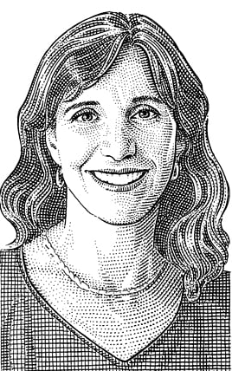
Rosaria Butterfield
Notes:
RO ZAR ia
Your book is titled The Secret Thoughts of an Unlikely Convert. Could you explain some of your "secret thoughts," and why you were an "unlikely convert"?
(Her book she was writing to “expose” – she was reasearching why the Religious right was so hateful and ignorant – why do they hate me? – hateful community / Why would decent people use Bible in harmful way – WROTE an editorial that received attention. / She received a letter from Ken Smith -- Pastor of Prespetarian church – In Ken and Floy’s home – their hospitality was a living breathing example of the theology they were teaching!
First Dinner at their house – closed with a big hug, and an invitation for dinner next week. They didn’t share the Gospel and they didni’t invite me to church. This was so wonderful. It showed me they didn’t see me as a project – but they saw me as a neighbor. She didn’t visit church for 2 years. But every week in their home.
She didn’t come to fiath because she stopped feeling like a lesbian. She came to faith because she believed Jesus is who he says he is.
Because we are neighbors we have opportunities throughout years to touch lives. God never gets the address wrong.
Why are you passionate about HOSPITALITY -- Connected to a radically CONVERTED person. Salvation is from GOD – but the highway was Ken and Foy’s hospitality.
Practice Hospitality according to checkbook and Calendar instead by the Blood of Christ.
Rosaria Butterfield: I considered myself an atheist, having rejected my Catholic childhood and what I perceived to be the superstitions and illogic of the historic Christian faith. I found Christians to be difficult, sour, fearful, and intellectually unengaged people. In addition, since the age of twenty-eight, I had lived in monogamous lesbian relationships and politically supported LGBT causes. I coauthored Syracuse University's first successful domestic partnership policy while working there as a professor of English and women's studies. I was terrified to aliate on any level with a worldview that called me, my life, my community, my scholarly interest, and my relationship sin. Add to this that I was working on a book "exposing" the religious right from a lesbian feminist point of view. I approached the Bible with an agenda to tear it down because I firmly believed that it was threatening, dangerous, and irrational.
But when I came to Christ, I experienced what nineteenth-century Scottish theologian Thomas Chalmers called "the expulsive power of a new affection." At the time of my conversion, my lesbian identity and feelings did not vanish. As my union with Christ grew, the sanctification that it birthed put a wedge between my old self and my new one. In time, this contradiction exploded, and I was able to claim identity in Christ alone.
TT: How has your story been received by Christians?
RB: The protagonist of Secret Thoughts is Pastor Ken Smith, who modeled to me organic Christian hospitality and the life-sustaining action of neighboring. Christian readers have responded to Ken's example and have been encouraged by it.

Slide 4
What trips up Christians is this: too much time waging war with people and ideas on social media, and too heavy a reliance on church programs to filter strangers, weeding out the creepy ones and bringing to your table the nice and safe ones. This post-Christian world won’t stand for this. And we shouldn’t either.
Get close enough to the stranger to put her hand into the hand of the Savior. -- Rosaria Butterfield
Notes:
TT: How do you respond to someone who says that one can continue to live a homosexual lifestyle and yet also be a Christian?
RB: First, I always start by asking for clarification about what she means by "Christian," often requesting that she share her testimony (and offering to share mine as well). She may tell me that she is a Christian because she believes in Jesus and said the sinner's prayer at a certain moment in her childhood. She also may tell me that she has a "high view" of Scripture and believes that the historic Christian church has misrepresented the issue of homosexuality. As I listen, I pray for the Lord to give me not only the words to say, but a transparent kindness that can uphold the weight of these words. I say I am glad that she believes in Jesus, but I share that the Bible calls for more than that, as even the trembling demons believe in Jesus. The Bible defines a Christian in a fuller way, including an understanding that:
(1) God set me apart from before the foundations of the world.
(2) The Holy Spirit removed my heart of stone and replaced it with a heart of flesh, leaving me with justifying faith.
(3) Jesus Christ infuses sanctifying grace through His hard-wrought love and blood.
(4) Repentance and belief go together, as both are gifts of God and fruit of Christian living. Without repentance there is no salvation.
Sometimes at this point in the conversation, she will ask me where she might meet this Jesus, because this is a different Jesus than the one that she knows. We open the Bible together, and I invite her to my house for dinner and church. Alternatively, if she tells me that she just interprets the Bible differently than I do, I then discuss how Jesus is inseparable from the Bible, and how the Bible is a unified revelation of God, fully true, inspired, and inerrant. At some point, if God allows, I suggest that we start reading the Bible together, reading systematically and not topically.
As you can see, I do not ask my questioner about why she identifies as lesbian or what this means to her, or when she first felt like a lesbian or had her first sexual experience. It is not that I don't care, but if I start with her, I start in the wrong place. Instead, I start with the triune God, and call out the soul-orientation of any person with whom I speak.
The Gospel Comes with a House Key: Practicing Radically Ordinary Hospitality in Our Post-Christian World
What role did hospitality play in your willingness to hear the gospel?
It made all the difference in the world—literally. Before I met Ken and Floy Smith, I understood the gospel as a metanarrative that depended on both ignorance and privilege.
What trips up Christians is this: too much time waging war with people and ideas on social media, and too heavy a reliance on church programs to filter strangers, weeding out the creepy ones and bringing to your table the nice and safe ones. This post-Christian world won’t stand for this. And we shouldn’t either.
Get close enough to the stranger to put her hand into the hand of the Savior.

Slide 5
HOSPITALITY in Scripture
philonexia- hospitableness.
This word is translated into “entertain strangers.”
Philonexia is made up of two different words:
philos which means loving
xenos which means stranger
Notes:
philoxenia, fil-ox-en-ee'-ah
Search for 5381 in KJV
I. from 5382; hospitableness:--entertain stranger, hospitality.
Heb 13:2 Be <epilanthanomai> not <me> forgetful <epilanthanomai> to entertain strangers <philoxenia>: for <gar> thereby <dia> <taute> some <tis> have entertained <xenizo> angels <aggelos> unawares <lanthano>.
Ro 12:13 Distributing to the necessity of saints; given to hospitality.
1Ti 3:2 A bishop then must be blameless, the husband of one wife, vigilant, sober, of good behaviour, given to hospitality, apt to teach; {of good...: or, modest}
Tit 1:8 But a lover of hospitality, a lover of good men, sober, just, holy, temperate; {men: or, things}
1Pe 4:9 Use hospitality one to another without grudging.
Some translate this word – (The Greek word Philoxenia, literally translated) as a “friend to a stranger”, is widely perceived to be synonymous to hospitality.
II. philoxenos, fil-ox'-en-os
Search for 5382 in KJV
from 5384 and 3581; fond of guests, i.e. hospitable:--given to (lover of, use) hospitality.

Slide 6
Its about our LOVE toward Strangers / LORD
Hebrews 13:1 Let brotherly love continue. 2 Do not forget to entertain strangers, for by so doing some have unwittingly entertained angels. 3 Remember the prisoners as if chained with them--those who are mistreated--since you yourselves are in the body also. 4 Marriage is honorable among all, and the bed undefiled; but fornicators and adulterers God will judge. 5 Let your conduct be without covetousness; be content with such things as you have. For He Himself has said, "I will never leave you nor forsake you."
6 So we may boldly say: "The LORD is my helper; I will not fear. What can man do to me?"
Notes:
Moral Dirctions / Relational Guidelines
Brotherly LOVE – How do you love the church
HOSPITALITY - HOW do YOU LOVE STRANGERS?
“Forgetful” – Lose out of MIND! Have you lost it? It can be found
LOVE STRANGERS – doesn’t demand the house –
God Drops an Easter Egg – Hey more good than you can know may be happening
Prisoners – maybe elaborating on HOSPITALITY
SPOUSES –
ATTITUDE and CONDUCT -- COVENTOUSNESS
philoxenia, fil-ox-en-ee'-ah
Search for 5381 in KJV
Heb 13 -- LOVE FOR STRANGERS – what would you do if you were KNEW the LORD was your HELPER? NO FEAR --
I. from 5382; hospitableness:--entertain stranger, hospitality.
Heb 13:2 Be <epilanthanomai> not <me> forgetful <epilanthanomai> to entertain strangers <philoxenia>: for <gar> thereby <dia> <taute> some <tis> have entertained <xenizo> angels <aggelos> unawares <lanthano>.
Ro 12:13 Distributing to the necessity of saints; given to hospitality.
1Ti 3:2 A bishop then must be blameless, the husband of one wife, vigilant, sober, of good behaviour, given to hospitality, apt to teach; {of good...: or, modest}
Tit 1:8 But a lover of hospitality, a lover of good men, sober, just, holy, temperate; {men: or, things}
1Pe 4:9 Use hospitality one to another without grudging.
Some translate this word – (The Greek word Philoxenia, literally translated) as a “friend to a stranger”, is widely perceived to be synonymous to hospitality.
II. philoxenos, fil-ox'-en-os
Search for 5382 in KJV
from 5384 and 3581; fond of guests, i.e. hospitable:--given to (lover of, use) hospitality.

Slide 7
Notes:
Introduction:
Stories Move Us!
I often say Facts are for the mind and Stories are for the Heart – they connect us. We tend to envision ourselves there – highly effective in connecting, making the bland material captivating – stories add color and depth.
Stories can shift perpective
Imagine a child saying – Give me bedtime facts and figure / No they ask for bedtime stories.
When Tracie and I started dating we would drive around or walk around and ask each other questions that would be answered with a story -- not, do you have parents – what are they like.
1, You walk into the room; slightly nervous, uncertain. The faces looking back at you are unfamiliar - not hostile, but not friendly either. Serious. "How was your journey?" asks one of them, and you tell them, explaining how you'd detoured to avoid an accident. Everyone nods. It's a blackspot. And so, over a story, you start to communicate.
Stories sit at the heart of communication and at the heart of learning. We use them to establish commonality, to build common frames of reference, to convey both easy and difficult messages and to share ideas. They are really the smallest unit of coherent information and the widest spread of knowledge. Stories are both powerful and elusive. We can all create and share them, but they don't all make sense. They are like a Trojan Horse, stories cause peope to let their gurd down. This is a story about how we learn.
2. Stories give access to new thoughts and additional feelings. Stories can be powerful – I grew up singing “Tell me the story of Jesus, write on my heart every word.”
Stories are plyable – they aren’t locked in to one stiff mold but bend, weave and wind into every family, culuture, and person.
Once upon a time or It was a dark and stormy night
3. TRACIE and I – sat around this campus – rode down the highway – just talking – telling stories – to get to know each other.

Slide 8
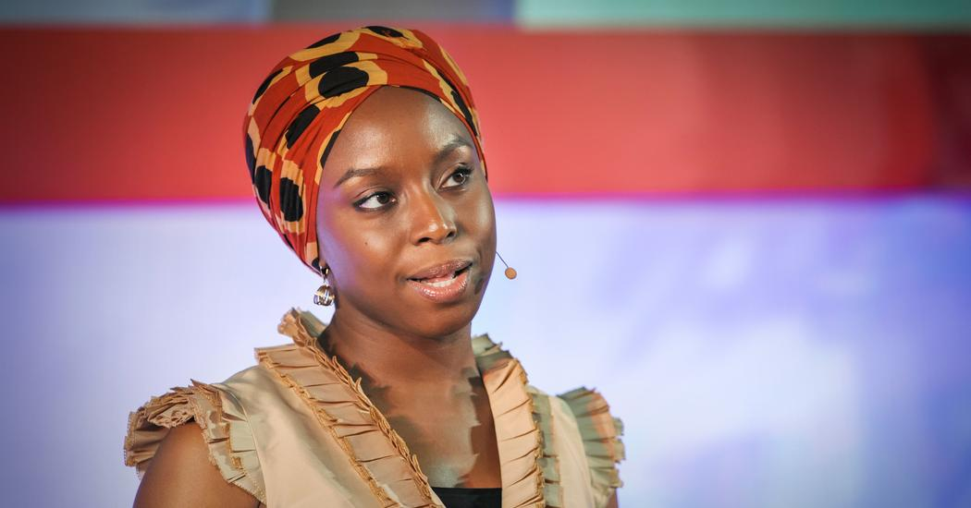
Notes:
Novelist and Storyteller (shh)Chim-muh-MAHN-duh enGOOzie ah-DEECH-ee-
Novelist Chimamanda Adichie tells the story of how she found her authentic cultural voice -- and warns that if we hear only a single story about another person or country, we risk a critical misunderstanding.
Throughout the lecture, she used personal anecdotes to illustrate the importance of sharing different stories. She briefly talked about the houseboy that was working for her family whose name is Fide and said the only thing she knew about him was how poor his family was. However, when Adichie's family visited Fide's village, Fide's mother showed them a basket that Fide's brother had made, making her realize that she created her opinion about Fide based on only one story of him. Adichie said, "It had not occurred to me that anybody in his family could actually make something. All I had heard about them was how poor they were, so that it had become impossible for me to see them as anything else but poor. Their poverty was my single story of them."^{[66]} She also said that when leaving Nigeria to go to Drexel University, she encountered the effects of the under-representation of her own culture. Her American roommate was surprised that Adichie was fluent in English and that she did not listen to tribal music.^{[67]} She said of this: "My roommate had a single story of Africa: a single story of catastrophe. In this single story, there was no possibility of Africans being similar to her in any way, no possibility of feelings more complex than pity, no possibility of a connection as human equals."^{[66]}
(8:54) – Show a people one thing, only one thing --- over and over again.
Have to talk about POWER if you talk single story – told over and over again – They learn only one thing.
Igbo word – she thinks of “nkali” noun translated “to be greater than another”
How they are told, who tells them, how often they are told
Palestinian poet Mourid Barghouti writes if you want to disposes a people the simplest way to do it is to tell their story and start with “secondly”. Start with the arrows of native Indian and not the arrival of the British and you have an entirely different story. Or start with the African failure of the failure of the African state and not the colonial creation of the African State and you have an entirely different story. (stopped at 11:00)
American Psycho – Are all young Americans serial murders?
A character in a novel doesn’t represent all
The negative stories are not who we are – only a part
Sterotypes are not necessary not true – but they are for certain incomplete
Single story robs people of Dignity
Father a professor and Mother an administrator – Their culture is to employee in their homes people from outer villiages where incomes are much less. When she was 8 a new house boy. Only thing she knew was that Fide (Va dee) was poor. Her mother would say things like “finish you food, don’t you know people like Fide family have nothing” So she felt enormous pity. But one day they visited his villiage / His mother showed up with beatful patterned baskets made of dyed Raffia (Raf(t) e (long) a (short)) that his brother had made. I was startled. I never imagined anyone n their family being capable of making anything. I only thought they were poor – only way I could see them because Poverty was my single Story.
She left Nigera at 19 to study in America – She remembered the same danger of a single story.
She moved into college. Her roommate knowing she was from Nigera was shocked she could speak English and asked where I learned to speak so well. She was confused when Chimamanda explained English is the official language of Nigeria. She asked if she could listen to her tribal music. She disappointed when she produced Mariah Carey. She assumed she didn’t know how to use a stove. It struck Chimamanda curiously that her roommate felt sorry for her before she acutualy knew her. It was a Patronizing, Well meaning Pity. She had a SINGLE STORY of Africa. A single story of Catastrophy. No possibility of them being similar to African. Complex no – pity, yes. And in America – anything that happened in Africa – they expected her to know it --- because it, for many, is one place – Africa.
Single story – Beautiful Landscapes, beautiful animals and incomprehensible people fighting sensless wars dieing of starvation and aids unable to speak for themselves.
Single stories are sometimes not even true – but they are never complete!
They rob people of dignity.
Xxxxxxxxxxxxxxxxxxxxxxxxxxxx
Chimamanda Ngozi Adichie
The Danger of a Single Story
ILL: 10:43
Introduction: Throughout the lecture, she used personal anecdotes to illustrate the importance of sharing different stories. She briefly talked about the houseboy that was working for her family whose name is Fide and said the only thing she knew about him was how poor his family was. However, when Adichie's family visited Fide's village, Fide's mother showed them a basket that Fide's brother had made, making her realize that she created her opinion about Fide based on only one story of him. Adichie said, "It had not occurred to me that anybody in his family could actually make something. All I had heard about them was how poor they were, so that it had become impossible for me to see them as anything else but poor. Their poverty was my single story of them."^{[66]} She also said that when leaving Nigeria to go to Drexel University, she encountered the effects of the under-representation of her own culture. Her American roommate was surprised that Adichie was fluent in English and that she did not listen to tribal music.^{[67]} She said of this: "My roommate had a single story of Africa: a single story of catastrophe. In this single story, there was no possibility of Africans being similar to her in any way, no possibility of feelings more complex than pity, no possibility of a connection as human equals."^{[66]}

Slide 9
Its about LOVE…
1 Peter 4:8 And above all things have fervent love for one another, for "love will cover a multitude of sins."
9 Be hospitable to one another without grumbling.
Notes:
Moral Dirctions / Relational Guidelines
Why so Important for an ELDER to HOSPITABLE?
It is true that at a time where Inns and hotels would not have been a prevalent, more people with little means – The need and opportunity for individuals to be in your home was significant and often.
2.
3. xxxx
philoxenia, fil-ox-en-ee'-ah
Search for 5381 in KJV
Heb 13 -- LOVE FOR STRANGERS – what would you do if you were KNEW the LORD was your HELPER? NO FEAR --
I. from 5382; hospitableness:--entertain stranger, hospitality.
Heb 13:2 Be <epilanthanomai> not <me> forgetful <epilanthanomai> to entertain strangers <philoxenia>: for <gar> thereby <dia> <taute> some <tis> have entertained <xenizo> angels <aggelos> unawares <lanthano>.
Ro 12:13 Distributing to the necessity of saints; given to hospitality.
1Ti 3:2 A bishop then must be blameless, the husband of one wife, vigilant, sober, of good behaviour, given to hospitality, apt to teach; {of good...: or, modest}
Tit 1:8 But a lover of hospitality, a lover of good men, sober, just, holy, temperate; {men: or, things}
1Pe 4:9 Use hospitality one to another without grudging.
Some translate this word – (The Greek word Philoxenia, literally translated) as a “friend to a stranger”, is widely perceived to be synonymous to hospitality.
II. philoxenos, fil-ox'-en-os
Search for 5382 in KJV
from 5384 and 3581; fond of guests, i.e. hospitable:--given to (lover of, use) hospitality.

Slide 10
Its about LOVE…
Romans 12:9 Let love be without hypocrisy. Abhor what is evil. Cling to what is good.
10 Be kindly affectionate to one another with brotherly love, in honor giving preference to one another;
11 not lagging in diligence, fervent in spirit, serving the Lord; 12 rejoicing in hope, patient in tribulation, continuing steadfastly in prayer; 13 distributing to the needs of the saints, given to hospitality.
Notes:
LOVE is ABOVE all things -- FERVANT LOVE –
Kindly Affectionate -- philostorgos, fil-os'-tor-gos from 5384 and storge (cherishing one's kindred, especially parents or children); fond of natural relatives, i.e. fraternal towards fellow Christian:--kindly affectioned
Brotherly Love – Philadelphia
Distributing – Koinoneo – Share with, partake with, partake --
3. xxxx
philoxenia, fil-ox-en-ee'-ah
Search for 5381 in KJV
Heb 13 -- LOVE FOR STRANGERS – what would you do if you were KNEW the LORD was your HELPER? NO FEAR --
I. from 5382; hospitableness:--entertain stranger, hospitality.
Heb 13:2 Be <epilanthanomai> not <me> forgetful <epilanthanomai> to entertain strangers <philoxenia>: for <gar> thereby <dia> <taute> some <tis> have entertained <xenizo> angels <aggelos> unawares <lanthano>.
Ro 12:13 Distributing to the necessity of saints; given to hospitality.
1Ti 3:2 A bishop then must be blameless, the husband of one wife, vigilant, sober, of good behaviour, given to hospitality, apt to teach; {of good...: or, modest}
Tit 1:8 But a lover of hospitality, a lover of good men, sober, just, holy, temperate; {men: or, things}
1Pe 4:9 Use hospitality one to another without grudging.
Some translate this word – (The Greek word Philoxenia, literally translated) as a “friend to a stranger”, is widely perceived to be synonymous to hospitality.
II. philoxenos, fil-ox'-en-os
Search for 5382 in KJV
from 5384 and 3581; fond of guests, i.e. hospitable:--given to (lover of, use) hospitality.

Slide 11
Its about LOVE…
Matthew 22:36-39
Teacher, which is the great commandment in the law?“ Jesus said to him," 'You shall love the LORD your God with all your heart, with all your soul, and with all your mind. "This is the first and great commandment.
And the second is like it: 'You shall love your neighbor as yourself.
Notes:
LOVE is ABOVE all things -- FERVANT LOVE –
Kindly Affectionate -- philostorgos, fil-os'-tor-gos from 5384 and storge (cherishing one's kindred, especially parents or children); fond of natural relatives, i.e. fraternal towards fellow Christian:--kindly affectioned
Brotherly Love – Philadelphia
Distributing – Koinoneo – Share with, partake with, partake --
3. xxxx
philoxenia, fil-ox-en-ee'-ah
Search for 5381 in KJV
Heb 13 -- LOVE FOR STRANGERS – what would you do if you were KNEW the LORD was your HELPER? NO FEAR --
I. from 5382; hospitableness:--entertain stranger, hospitality.
Heb 13:2 Be <epilanthanomai> not <me> forgetful <epilanthanomai> to entertain strangers <philoxenia>: for <gar> thereby <dia> <taute> some <tis> have entertained <xenizo> angels <aggelos> unawares <lanthano>.
Ro 12:13 Distributing to the necessity of saints; given to hospitality.
1Ti 3:2 A bishop then must be blameless, the husband of one wife, vigilant, sober, of good behaviour, given to hospitality, apt to teach; {of good...: or, modest}
Tit 1:8 But a lover of hospitality, a lover of good men, sober, just, holy, temperate; {men: or, things}
1Pe 4:9 Use hospitality one to another without grudging.
Some translate this word – (The Greek word Philoxenia, literally translated) as a “friend to a stranger”, is widely perceived to be synonymous to hospitality.
II. philoxenos, fil-ox'-en-os
Search for 5382 in KJV
from 5384 and 3581; fond of guests, i.e. hospitable:--given to (lover of, use) hospitality.

Slide 12
1st and 2nd Greatest Commandments
The second is to LOVE NEIGHBORS
But the Second isn’t the FIRST
The Second is the Second
The ORDER is Important
Notes:
We can’t get this right w/o the proper ORDER
Love as JESUS LOVES
Matt 22:36-37 Love neighbor as YOURSELF
John 13:34-35 -- Love neighbor as JESUS LOVED YOU
Then in John

Slide 13
Hospitality Touches Eternity…
Matthew 25:34 Then the King will say to those on His right hand, 'Come, you blessed of My Father, inherit the kingdom prepared for you from the foundation of the world: 35 'for I was hungry and you gave Me food; I was thirsty and you gave Me drink; I was a stranger and you took Me in; 36 'I was naked and you clothed Me; I was sick and you visited Me; I was in prison and you came to Me.'
Notes:
LOVE is ABOVE all things -- FERVANT LOVE –
Kindly Affectionate -- philostorgos, fil-os'-tor-gos from 5384 and storge (cherishing one's kindred, especially parents or children); fond of natural relatives, i.e. fraternal towards fellow Christian:--kindly affectioned
Brotherly Love – Philadelphia
Distributing – Koinoneo – Share with, partake with, partake --
3. xxxx
philoxenia, fil-ox-en-ee'-ah
Search for 5381 in KJV
Heb 13 -- LOVE FOR STRANGERS – what would you do if you were KNEW the LORD was your HELPER? NO FEAR --
I. from 5382; hospitableness:--entertain stranger, hospitality.
Heb 13:2 Be <epilanthanomai> not <me> forgetful <epilanthanomai> to entertain strangers <philoxenia>: for <gar> thereby <dia> <taute> some <tis> have entertained <xenizo> angels <aggelos> unawares <lanthano>.
Ro 12:13 Distributing to the necessity of saints; given to hospitality.
1Ti 3:2 A bishop then must be blameless, the husband of one wife, vigilant, sober, of good behaviour, given to hospitality, apt to teach; {of good...: or, modest}
Tit 1:8 But a lover of hospitality, a lover of good men, sober, just, holy, temperate; {men: or, things}
1Pe 4:9 Use hospitality one to another without grudging.
Some translate this word – (The Greek word Philoxenia, literally translated) as a “friend to a stranger”, is widely perceived to be synonymous to hospitality.
II. philoxenos, fil-ox'-en-os
Search for 5382 in KJV
from 5384 and 3581; fond of guests, i.e. hospitable:--given to (lover of, use) hospitality.

Slide 14
Hospitality Touches Eternity…
Matthew 25:37 "Then the righteous will answer Him, saying, 'Lord, when did we see You hungry and feed You, or thirsty and give You drink? 38 'When did we see You a stranger and take You in, or naked and clothe You?
39 'Or when did we see You sick, or in prison, and come to You?‘
40 "And the King will answer and say to them, 'Assuredly, I say to you, inasmuch as you did it to one of the least of these My brethren, you did it to Me.'
Notes:
LOVE is ABOVE all things -- FERVANT LOVE –
Kindly Affectionate -- philostorgos, fil-os'-tor-gos from 5384 and storge (cherishing one's kindred, especially parents or children); fond of natural relatives, i.e. fraternal towards fellow Christian:--kindly affectioned
Brotherly Love – Philadelphia
Distributing – Koinoneo – Share with, partake with, partake --
3. xxxx
philoxenia, fil-ox-en-ee'-ah
Search for 5381 in KJV
Heb 13 -- LOVE FOR STRANGERS – what would you do if you were KNEW the LORD was your HELPER? NO FEAR --
I. from 5382; hospitableness:--entertain stranger, hospitality.
Heb 13:2 Be <epilanthanomai> not <me> forgetful <epilanthanomai> to entertain strangers <philoxenia>: for <gar> thereby <dia> <taute> some <tis> have entertained <xenizo> angels <aggelos> unawares <lanthano>.
Ro 12:13 Distributing to the necessity of saints; given to hospitality.
1Ti 3:2 A bishop then must be blameless, the husband of one wife, vigilant, sober, of good behaviour, given to hospitality, apt to teach; {of good...: or, modest}
Tit 1:8 But a lover of hospitality, a lover of good men, sober, just, holy, temperate; {men: or, things}
1Pe 4:9 Use hospitality one to another without grudging.
Some translate this word – (The Greek word Philoxenia, literally translated) as a “friend to a stranger”, is widely perceived to be synonymous to hospitality.
II. philoxenos, fil-ox'-en-os
Search for 5382 in KJV
from 5384 and 3581; fond of guests, i.e. hospitable:--given to (lover of, use) hospitality.

Slide 15
Raising the Bar
"A new commandment I give to you, that you love one another; as I have loved you, that you also love one another.
By this all will know that you are My disciples, if you have love for one another.“
John 13:34-35
Notes:
We can’t get this right w/o the proper ORDER
Love as JESUS LOVES
Matt 22:36-37 Love neighbor as YOURSELF
John 13:34-35 -- Love neighbor as JESUS LOVED YOU
Then in John

Slide 16
Application
Notes:
We can’t get this right w/o the proper ORDER
Love as JESUS LOVES
Matt 22:36-37 Love neighbor as YOURSELF
John 13:34-35 -- Love neighbor as JESUS LOVED YOU
Then in John

Slide 17
Guest at Church
James 2:1 My brethren, do not hold the faith of our Lord Jesus Christ, the Lord of glory, with partiality…
(our response to the rich and poor in church)
…8 If you really fulfill the royal law according to the Scripture, "You shall love your neighbor as yourself," you do well; 9 but if you show partiality, you commit sin, and are convicted by the law as transgressors.
Notes:
Showing Love
Guest at CHURCH
Matthew 25 hungry
Luke 14 – resurrection
James 1:27 many widows and orphans who need someone to show up

Slide 18
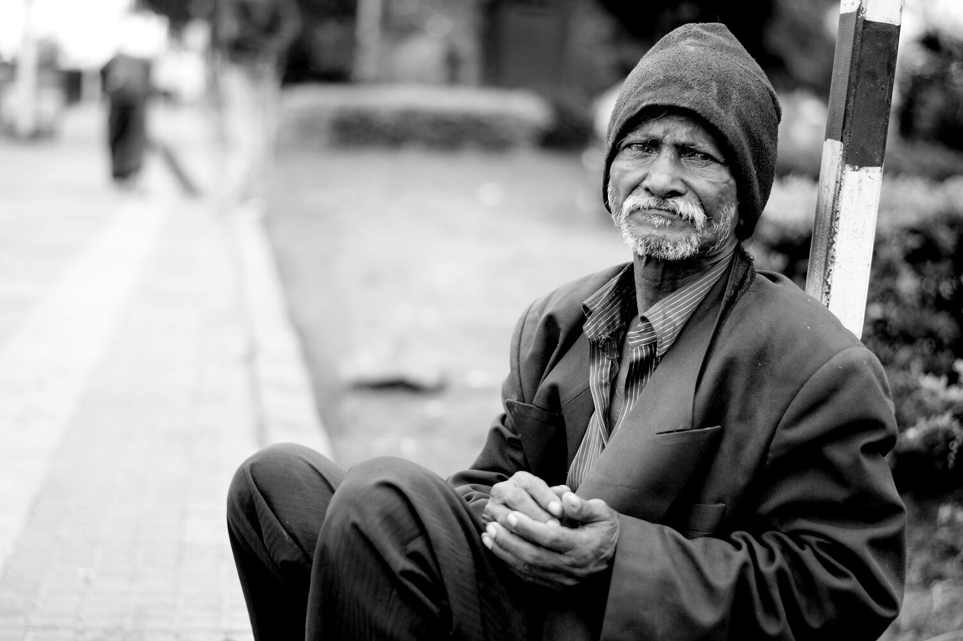
Guest at Church
Notes:
Showing Love
Guest at CHURCH
Matthew 25 hungry
Luke 14 – resurrection
James 1:27 many widows and orphans who need someone to show up

Slide 19
Guest in Your Home
Luke 14:12 Then He also said to him who invited Him, "When you give a dinner or a supper, do not ask your friends, your brothers, your relatives, nor rich neighbors, lest they also invite you back, and you be repaid.
13 But when you give a feast, invite the poor, the maimed, the lame, the blind. 14 And you will be blessed, because they cannot repay you; for you shall be repaid at the resurrection of the just.“
Notes:
Showing Love
Guest at CHURCH
Matthew 25 hungry
Luke 14 – resurrection
James 1:27 many widows and orphans who need someone to show up

Slide 20
Hospitable Visits
James 1:27 Pure and undefiled religion before God and the Father is this: to visit orphans and widows in their trouble, and to keep oneself unspotted from the world.
Notes:
Showing Love
Guest at CHURCH
Matthew 25 hungry
Luke 14 – resurrection
James 1:27 many widows and orphans who need someone to show up

Slide 21
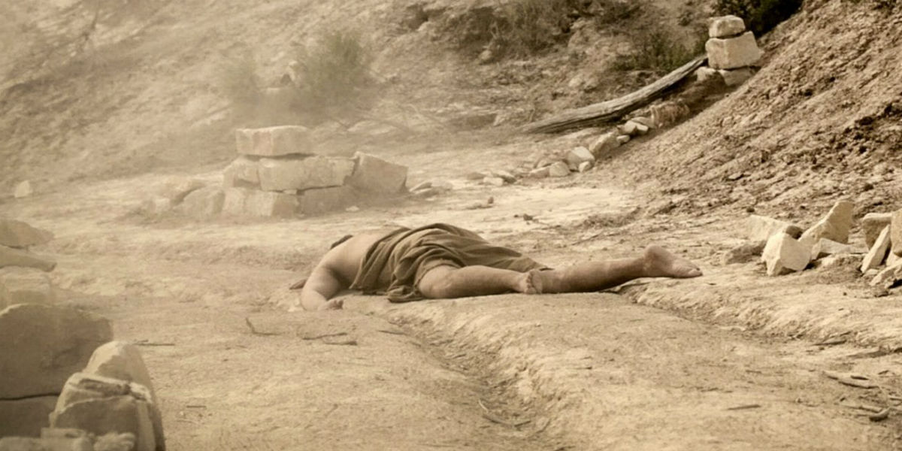
Throughout Your Day
Notes:
Showing Love
Guest at CHURCH
Matthew 25 hungry
Luke 14 – resurrection
James 1:27 many widows and orphans who need someone to show up

Slide 22
Loving Strangers throughout Your Day
Luke 10:29 But he, wanting to justify himself, said to Jesus, "And who is my neighbor?"
30 Then Jesus answered and said: "A certain man went down from Jerusalem to Jericho, and fell among thieves, who stripped him of his clothing, wounded him, and departed, leaving him half dead…
Notes:
Showing Love
Guest at CHURCH
Matthew 25 hungry
Luke 14 – resurrection
James 1:27 many widows and orphans who need someone to show up

Slide 23
Loving Strangers
Luke 10:33 But a certain Samaritan, as he journeyed, came where he was. And when he saw him, he had compassion…
36 So which of these three do you think was neighbor to him who fell among the thieves?"
37 And he said, "He who showed mercy on him." Then Jesus said to him, "Go and do likewise."
Notes:
Compassion - middle voice from 4698; to have the bowels yearn, i.e. (figuratively) feel sympathy, to pity:--have (be moved with) compassion.
APP: People show compassion when they put themselves in the other person’s shoes.
Mercy - compassion (human or divine, especially active):--(+ tender) mercy.

Slide 24
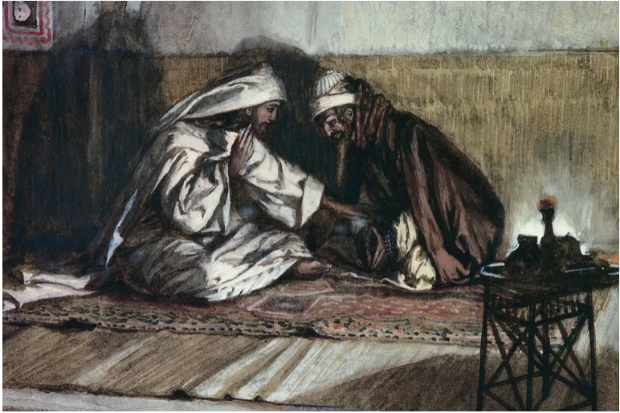
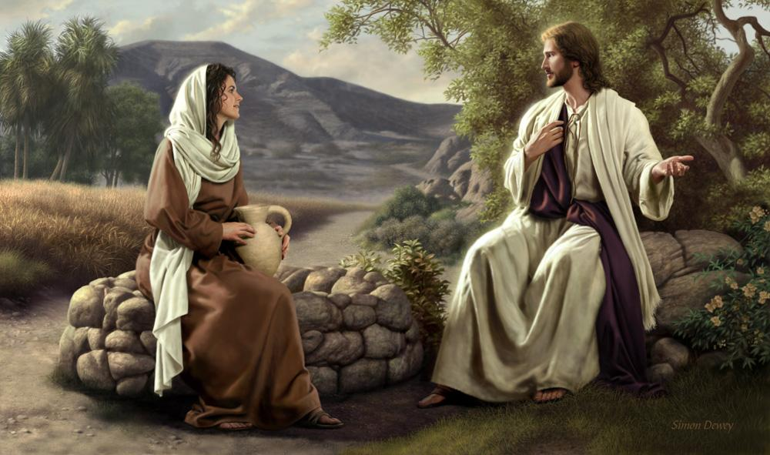
Strangers Have Souls
Notes:
John 3 – Nicodemius
John 3:16
John 4 – Woman at the Well
Mother set up Bible Studies at Lunch
I set up Bible Studies in Office
Brian Oldham sets up studies on his back porch

Slide 25
God Rewards this Behavior
Acts 20:35 I have shown you in every way, by laboring like this, that you must support the weak. And remember the words of the Lord Jesus, that He said, “It is more blessed to give than to receive."
2 Corinthians 9:8 And God is able to make all grace abound toward you, that you, always having all sufficiency in all things, may have an abundance for every good work.
Notes:
Compassion - middle voice from 4698; to have the bowels yearn, i.e. (figuratively) feel sympathy, to pity:--have (be moved with) compassion.
APP: People show compassion when they put themselves in the other person’s shoes.
Mercy - compassion (human or divine, especially active):--(+ tender) mercy.

Slide 26
Notes:
Sharing Jesus with Someone through Radical Hospitality
Note that each session will last 45 minutes and you have access to Powerpoint and the internet, if needed.
Hospitality and Neighboring
Romans 12:10ff
Good Samaritan – Neighborly is ultimately a willingness to bear the image of Christ
Another key issue is this: radically ordinary hospitality is never convenient. A good question to ask yourself: What is the difference between inconvenient and impossible?
Second Application: Radical Hospitilty may not be in your home: (lets give each other permission to stretch it…)
1. My Office every Tuesday
2. Scheduled Lunches with Intentionality – My mother set up Bible studies at lunch
3.
Acts 2 were homes the bridge to the church?
James 2 – At church
Usuage of terms in scripture “Hospitality” / “Neighboring”
Single Story
Remember – what do we portray when we share Christ and they don’t respond through faith? The world is watching.
Hospitality and Compassion
Is the way to show the authentic Love and grace Jesus Shared with us
World has Negative Labels of Christians – but many in the world do not know a Christian
Personal Connections – Avoid Single Story pitfalls
Xxxxxxxxxxxxxxxxxxxxxxxxxxxxxxxxxxxxxxxx
NOT ENOUGH CHAIRS
The new preacher loaded his car with his large family and visited an
old deacon on the farm. After the introductions there was an awkward
pause as the unexpected guests looked for chairs upon which to sit.
The parlor had only two chairs.
"Brother, I don't believe you have enough chairs," suggested the
preacher.
"That ain't it," muttered the old man. "I got plenty of chairs --
just too much company!"
Some Christians make it clear they don't want to spend too much time
with other Christians, but how important is our fellowship with our
brothers and sisters in Christ! Living in a hostile environment, we
need the encouragement that comes from those who share the same hopes
and goals that we do.
God knew that we would need each other, that the Christian life would
be difficult if not impossible to live in isolation. That's what the
church is all about. The early Christians certainly recognized the
value of being together:
"Every day they continued to meet together in the temple courts. They
broke bread in their homes and ate together with glad and sincere
hearts." (Acts 2:46, NIV)
Take time today to spend a few moments with a fellow Christian,
encouraging and being encouraged. Just be sure to have plenty of
chairs ready!

